Slide 1


DAT204 How Thermo Fisher Is Reducing Mass Spectrometry Experiment Times from Days to Minutes with MongoDB & AWS

Slide 2

World leader in serving science
Revenues of $17 billion
50,000 employees
50 countries
Notes:
ThermoFisher is the biggest company you’ve never heard about, we have 50,000 employees around the world. ThermoFisher is the world leader in serving science.

Slide 3
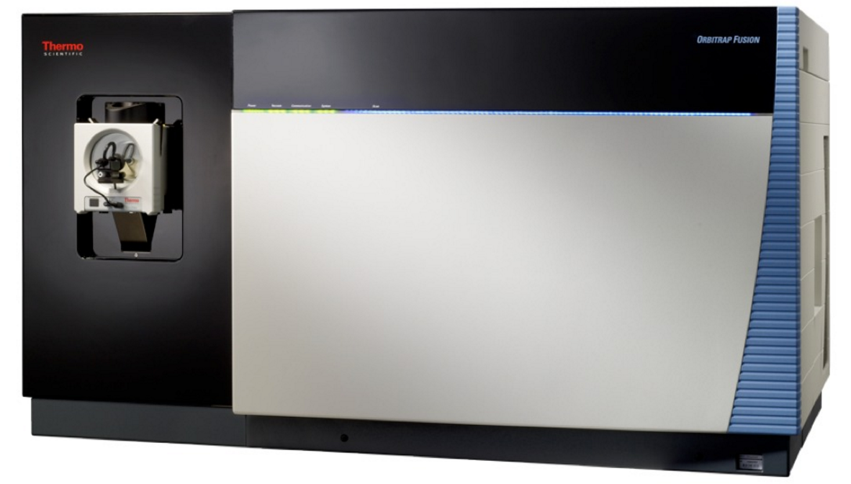
A Mass Spectrometer tells you…
What’s in there and how much
Notes:
One of the ways we do this is by manufacturing an instrument called a Mass Spectrometer. A Mass Spectrometer has become the gold standard for telling you what is in your sample and how much down to the mass of an electron, which is really, really accurate.
The sample is injected into the front of the instrument, ionized and then spun around in a ping-pong size metal sphere. Larger molecules have longer wavelengths and smaller molecules have shorter wavelengths.
It turns out there are quite a few applications for this capability.

Slide 4


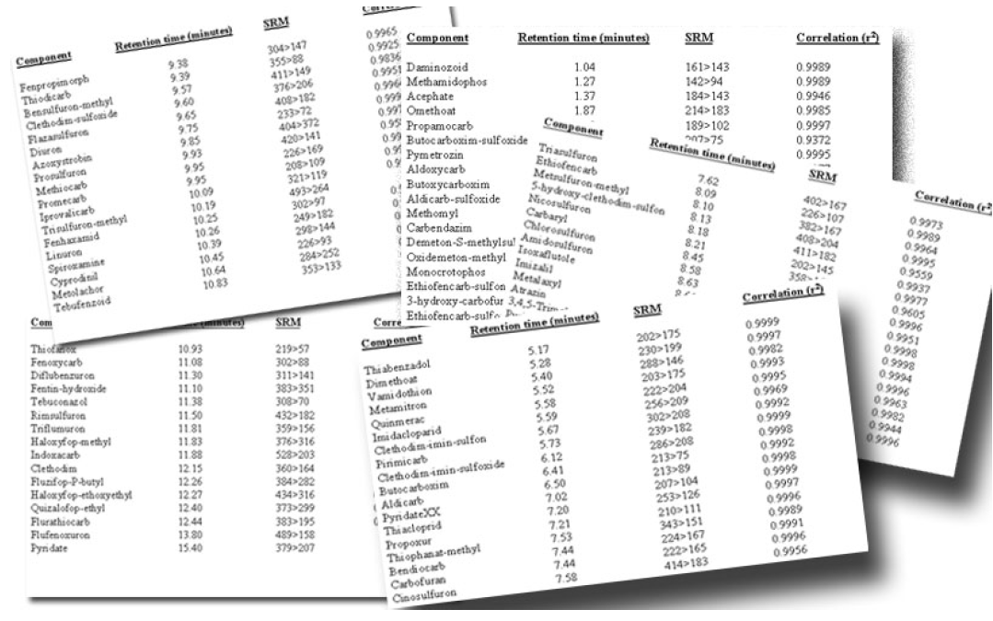
Notes:
ThermoFisher Mass Spectrometry instruments are used to detect Pollutants, if it is bad for you, our instruments will detect it.
One of our customers is the Karolinska institute in Sweden, (this is the same university responsible for giving out Nobel prizes) and they have dozens of ThermoFisher instruments which processes 100k samples per year serving all of Sweden. Each of their high resolution instruments produces 100TB data per year.

Slide 5

Making the world healthier, cleaner and safer
Notes:
ThermoFisher’s motto is to make the world healthier, cleaner, and safer. For me, this is personally meaningful. My son Landon was born with a Cleft lip and Pallet which is caused at least in part by exposure of the baby at a very early age (when they are just pea size) to a toxin: mercury, lead, a volatile organic, for example. So preventing other children from being born with birth with defects and having safe and healthy lives is one thing that motivates me to come to work every day.

Slide 6
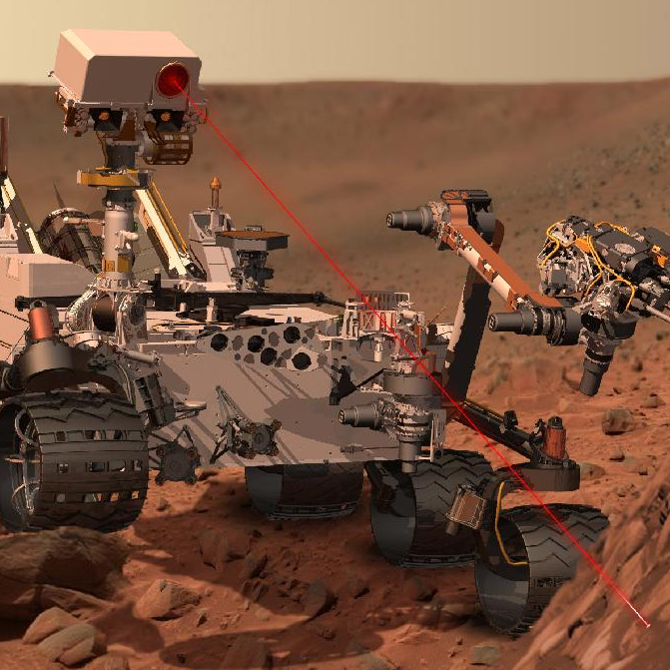
Mars Organic Molecule Analyzer (MOMA) will take a modified Thermo Linear Ion Trap Mass Spectrometer to Mars in 2020
Notes:
The next mission to mars in 2020 will carry a mass spec based on a ThermoFisher design. The instrument is called the Mars Organic Molecule Analyzer, or MOMA. It has the ability to detect molecular molecules in smaller quantities than any instrument ever before it. It will be interesting to see the results. Any discovery would be significant.
[Extra]
Mars rover is not running MongoDB, but maybe as the NASA trend continues for using commercial products and Thermo increasingly adapts MongoDB, MongoDB will ship on a Mars Rover some day. You definitely couldn’t run DynamoDB on the mars rover, but you could run Mongo.
----
http://science.gsfc.nasa.gov/sed/bio/veronica.t.pinnick
https://ep70.eventpilot.us/web/planner.php?id=ASMS16
Mars Organic Molecule Analyzer (MOMA) Mass Spectrometer: Performance Testing in GC-MS and LD-MS Modes of Operation

Slide 7
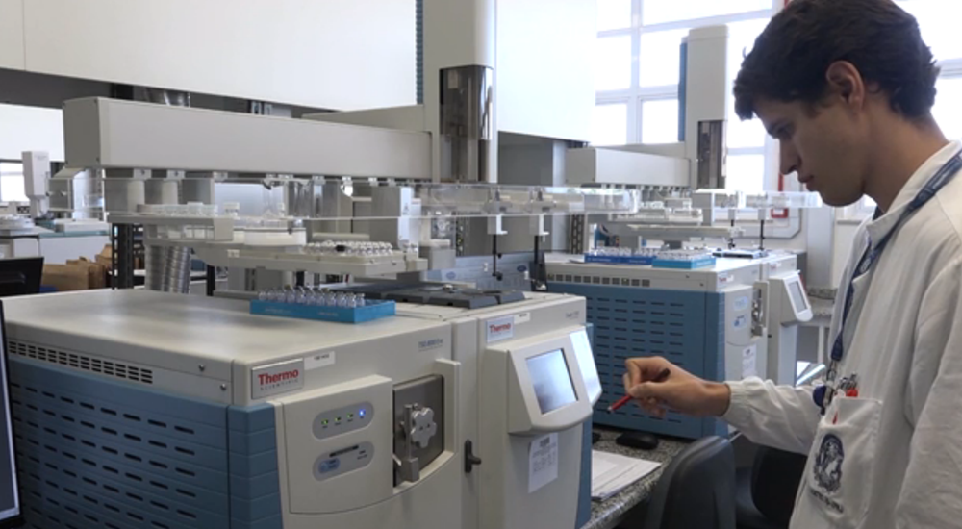
Notes:
Our mass spectrometers are used in major sporting events to ensure an even playing field by detecting banned performance enhancing drugs.
[reference]
http://www.nbcnews.com/storyline/2016-rio-summer-olympics/rio-olympics-top-anti-doping-scientist-cheats-will-probably-be-n573531

Slide 8
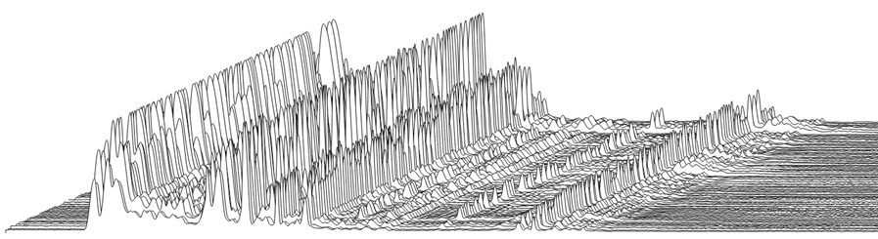
What beer looks like in a mass spec
Notes:
So this is what beer looks like in a mass spec. This is 100 samples of various types of beer. Each one of the variations in these peaks represents the unique flavonoids that make a product unique and give it a distinct smell and flavor.
Our mass spectrometers are used for product authenticity studies.

Slide 9


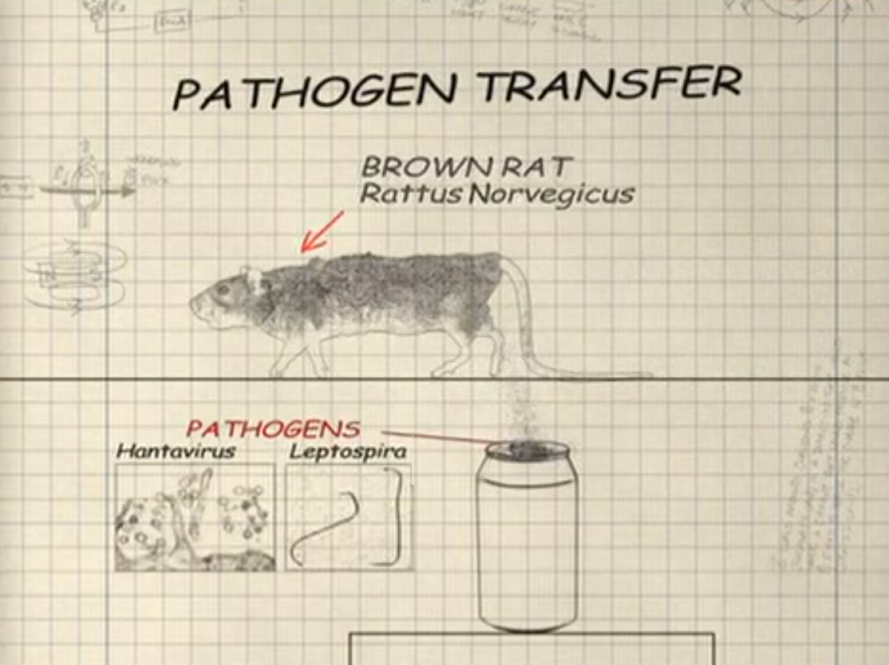
Notes:
Any MythBuster fans out there? Adam Savage actually spoke at the keynote of MongoDB world 2016 in New York, so that is why I am a Mongo fan, never mind the technical merits.
In 2009 The Mythbusters Adam and Jamie use ThermoFisher Mass Spectrometer to determine if soda cans have rat pee on them. Really great episode, just search for “Rat Pee Soda”.
In the experiment, they take 1000 soda cans and let rats run and pee all over them. And then take soda cans from local convenience stores and compare the two sets of cans using a black light. Using the black light, both sets look similar. Organic material glowing under the black light. However, when they take the rat pee cans and the convenience store cans to the Stanford analytical lab, the mass spectrometer is able to conclusively determine that no rat pee is found on the convenience store cans.
[reference]
Episode 135
http://www.dailymotion.com/video/x2n9enp (Starting at minute 7:30 Jamie and Adam visit Stanford lab and use Thermo Mass Specs)

Slide 10
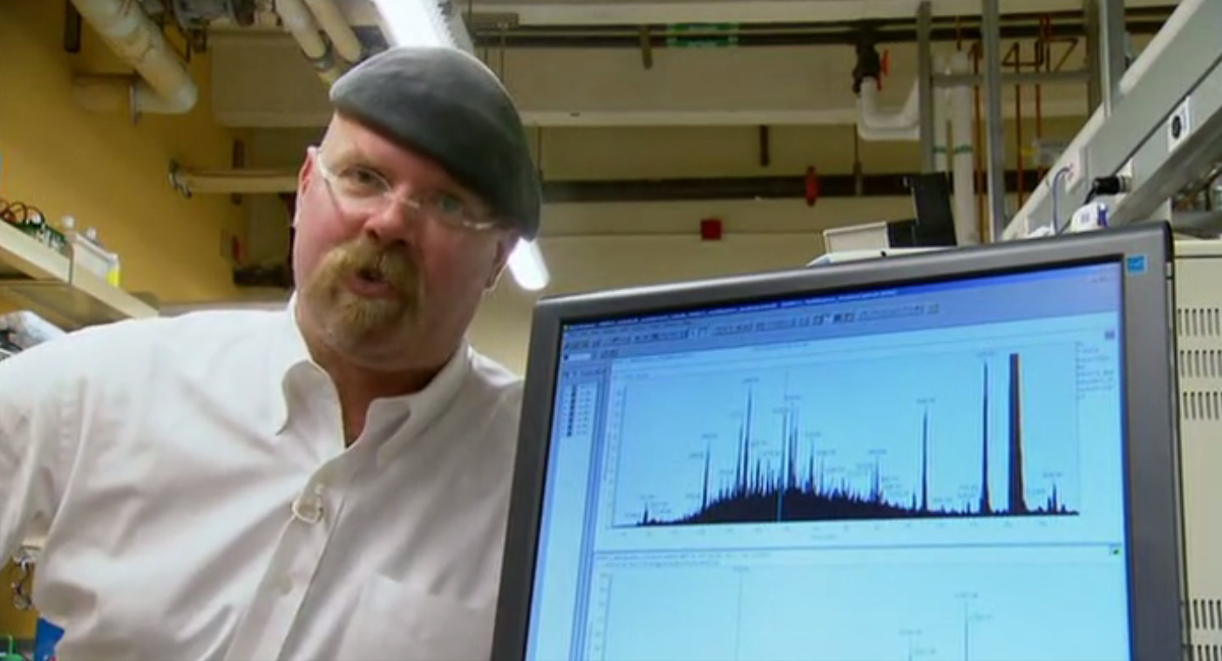
Notes:
Jamie Says quote “These Mass Spectrometers are extremely accurate, they can detect down to a femptomole, and if it says they aren’t in there, its not in there.”
Adam was very relieved by this result and drank a soda.

Slide 11
Demo

Slide 12

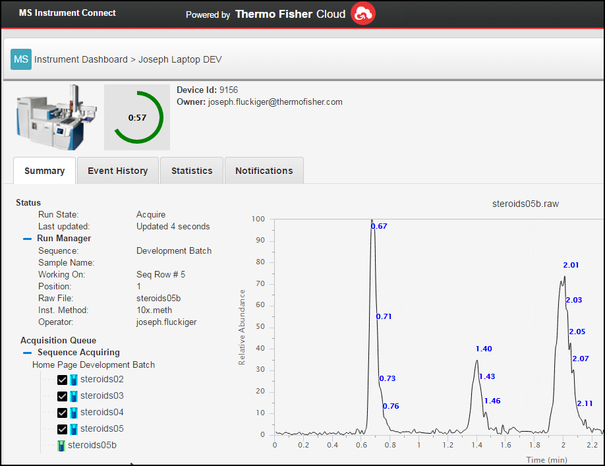
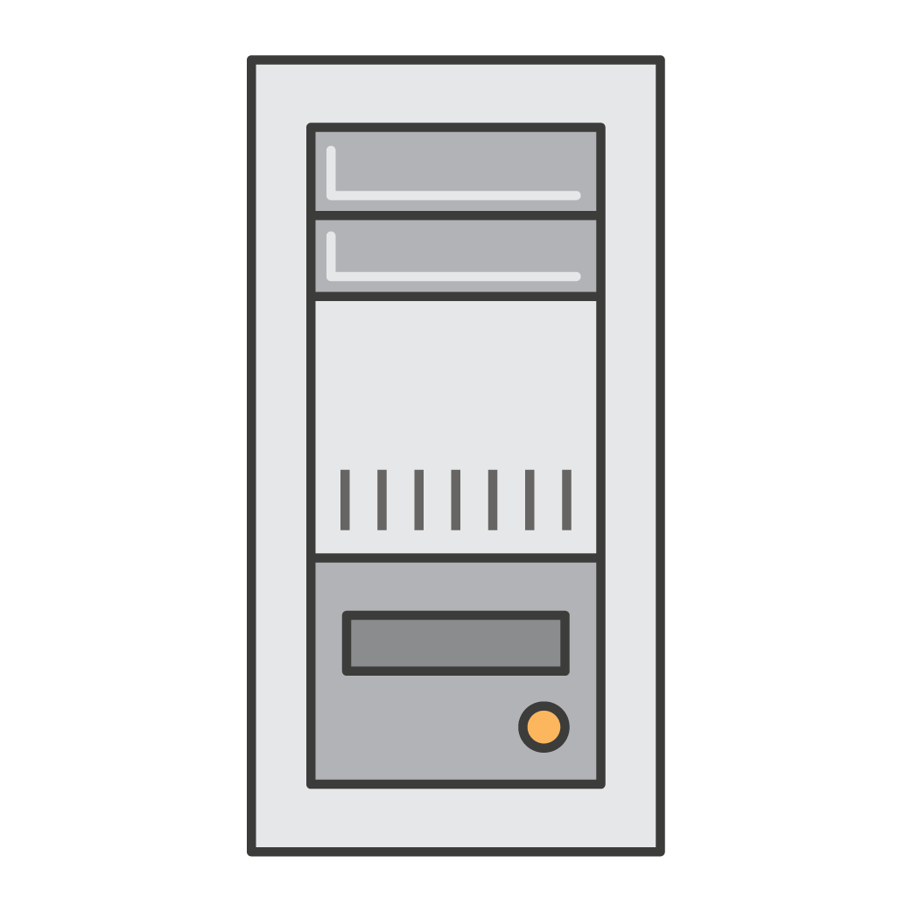



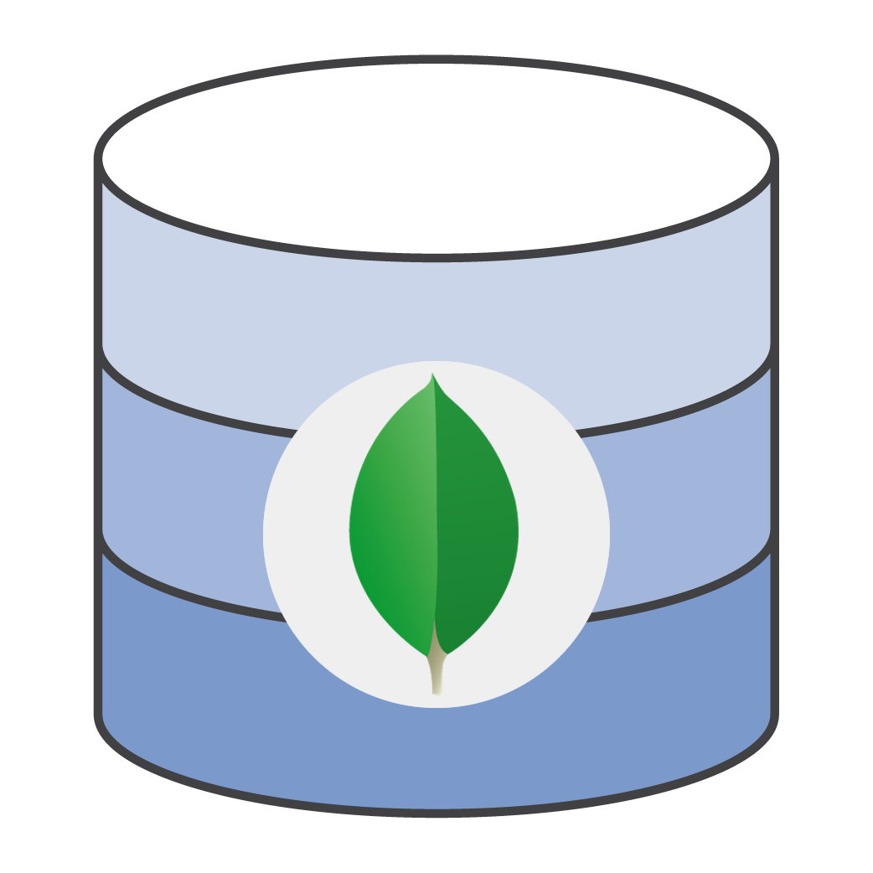
Demo: Instrument Connect
Instrument
MS Instrument Connect
MongoDB
Notes:
To keep things interesting, I am going to do a live demo. I am going to kick of an acquisition in a Mass Spec which is connected to ThermoFisher cloud built on AWS. I will then open a browser which is also connected to ThermoFisher cloud and can monitor the status of the instrument and the data being acquired. The database which stores instrument status and data is MongoDB Atlas.

Slide 13
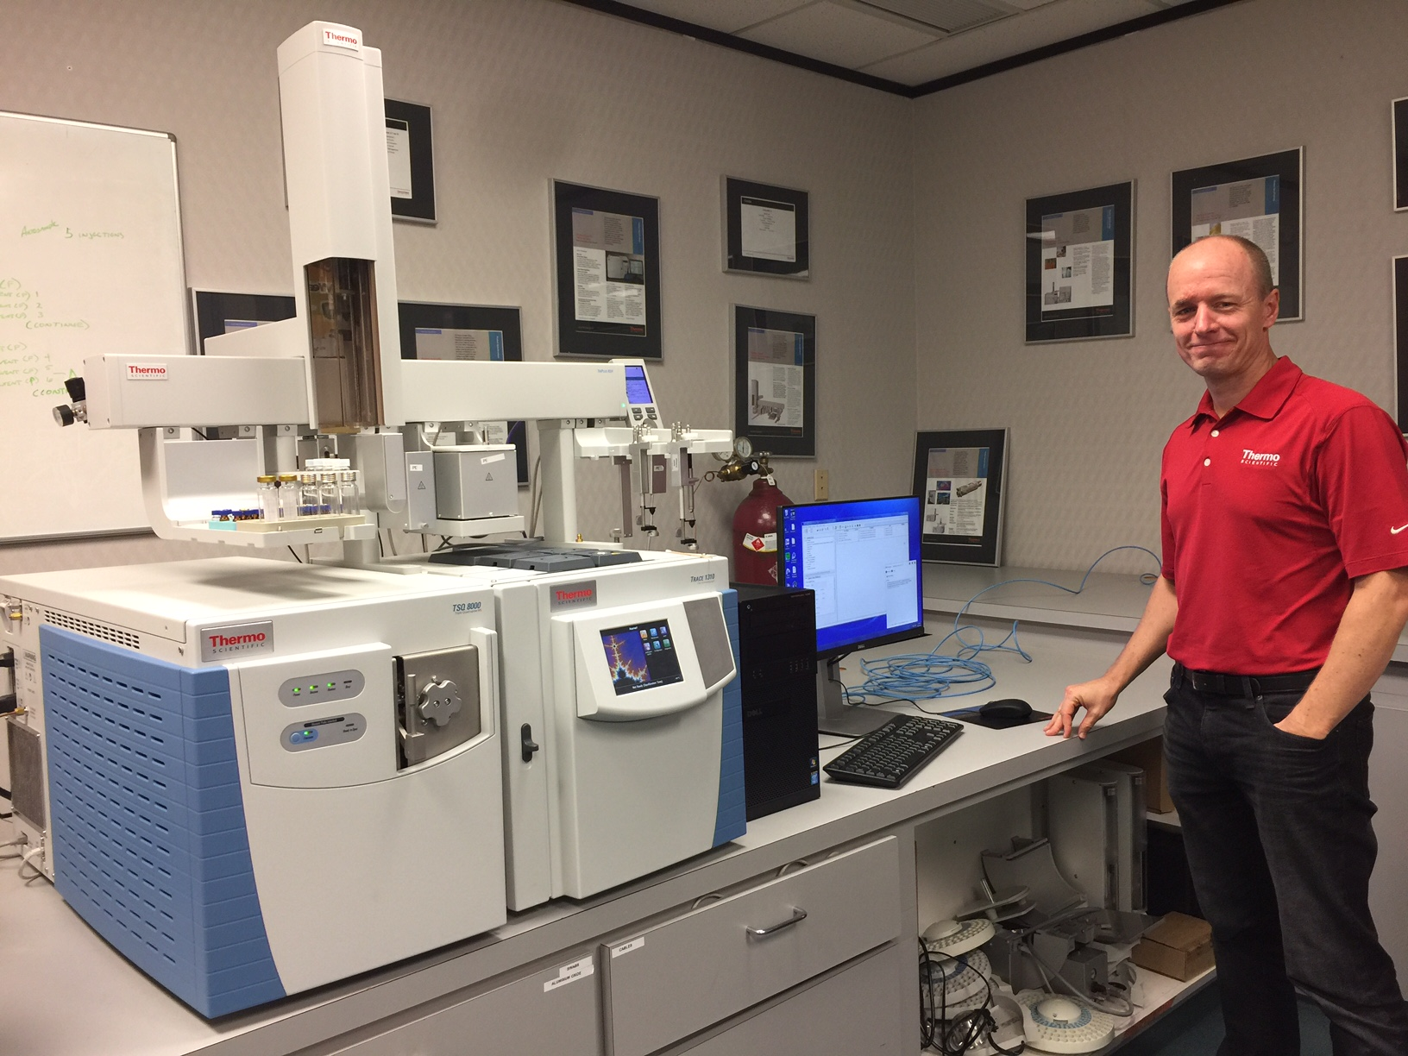
Demo: remote monitoring a mass spectrometer
Notes:
Humor: Apparently this is the only shirt I own. This is the mass spec we will be remote monitoring.
Explain: Auto Sampler, Gas Chromatograph, and Mass Spec
[Demo outline]
Open MS Instrument TraceFinder 7
Open Atlas Dashboard spin up new cluster – “This would have taken a few days of my time to set up”
[Optional]
Show ThermoFisher Cloud AppConnect and Swift

Slide 14
Why does Thermo use MongoDB?

Slide 15
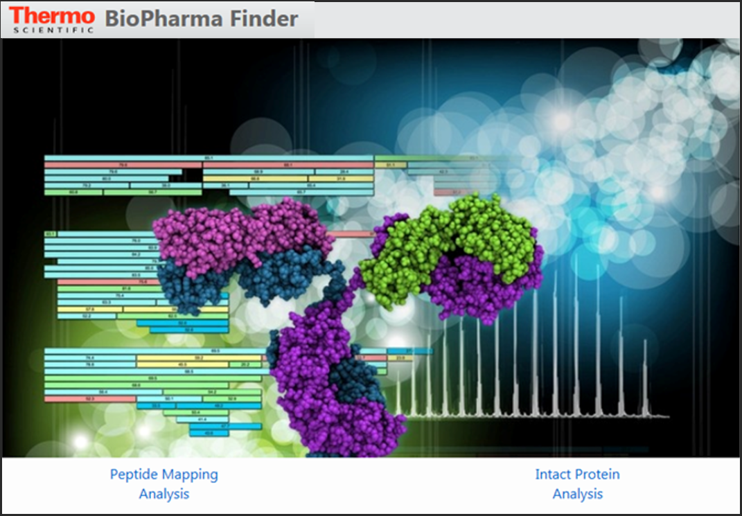
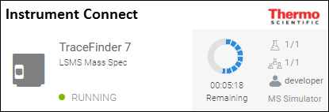
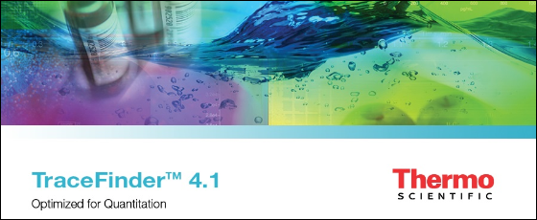
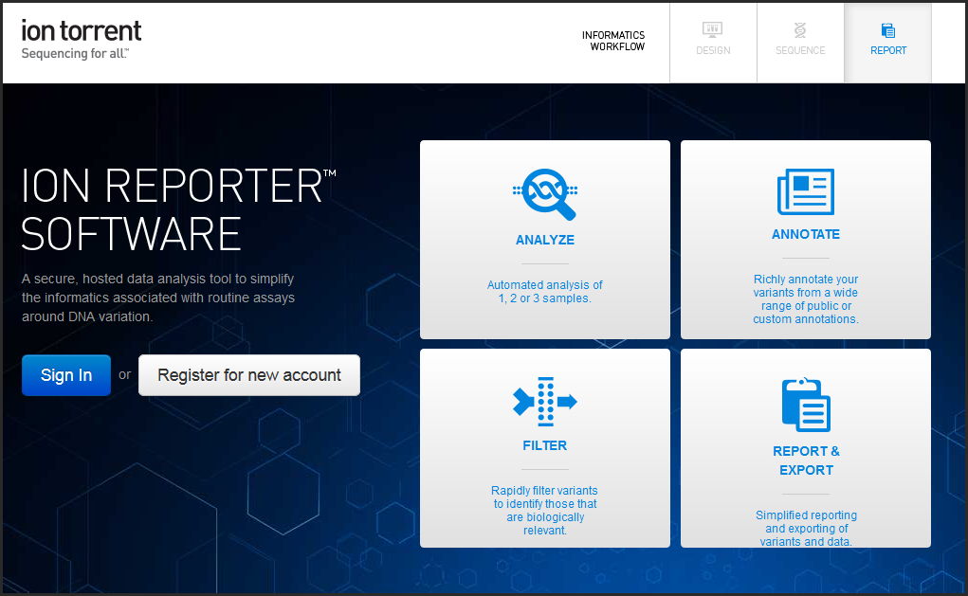

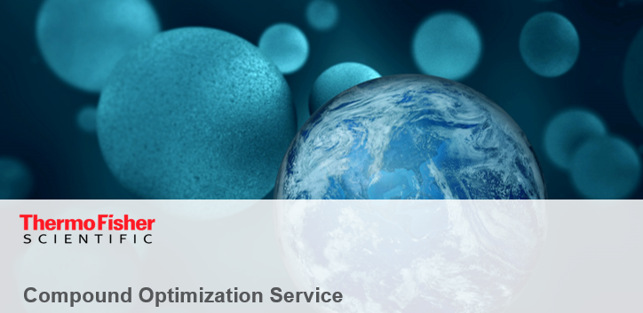
ThermoFisher apps using MongoDB
Amazon DynamoDB → MongoDB Atlas
SQL Lite → MongoDB
XML → MongoDB
Postgres → MongoDB
Oracle → MongoDB
Starting on MongoDB
Notes:
ThermoFisher is increasingly using MongoDB in its applications. Over the past couple years we have been doing performance and productivity benchmarks to compare MongoDB to other databases and MongoDB has consistently come out on top in these studies.
In the bottom left is ThermoFisher.com, all products purchased through the website go through MongoDB. The app in the top left is the one I just demoed.

Slide 16
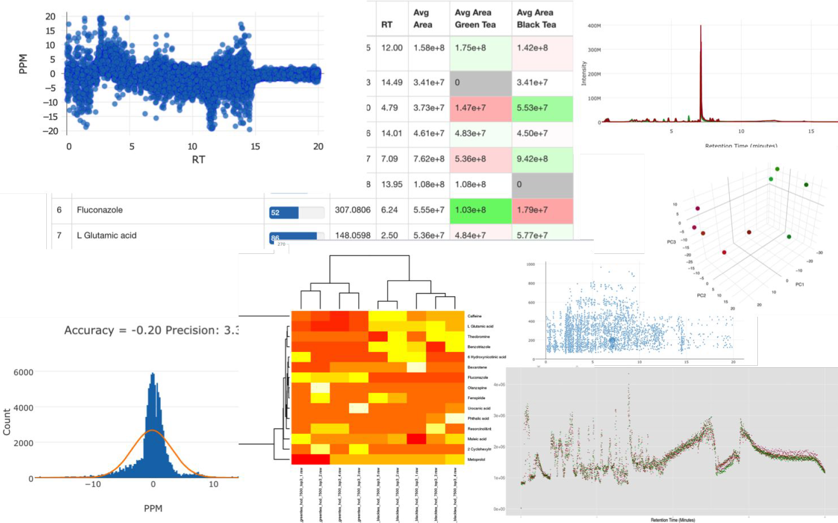
Scientific apps = humongous data
Notes:
Scientific applications contain a variety of data which needs to be visualized in many diverse ways.

Slide 17

Big molecules = big data
Notes:
If take a microscope and zoom down, this is what you look like. This is a protein. These molecules are large and there are many variants, and when this is taken in compensation with the fact that Mass Spectrometers have become so sensitive that they can measure down to the mass of an electron, this results in a huge amount of data. We need a database which can handle this volume of data.

Slide 18
Why MongoDB was chosen
Performance
Developer productivity
Cost effective
Runs anywhere
Rich feature set
Achieved legal and regulatory approval
instrument {
UserId : "dr.ennis@poldark.net",
MachineName : "TRACEFINDER8",
Location : "Austin",
AcquisitionStationName : "TSQ 8000",
LastErrorEventDate : "2016-09-05",
LastErrorEventValue : null,
RuntimeEstimate : {
MeasuredElaspedDuration : 0.21966,
Confidence : HighConfidence
},
RunManagerStatus : {
Status : "Acquire",
Sequence : "Testosterone",
SampleName : "Drugx",
VialPosition : "1",
Rawfile : "2pg_161029205505",
Instmethod : "1x.meth",
Instrument : "TSQ 8000",
IsPaused : false,
Operator : "Fred",
}
}
Notes:
MongoDB is performant

Slide 19

MongoDB is a Swiss army knife
Hierarchical data
Relational data
Queues
File storage
Device state
Notes:
MongoDB can store many types of data. Using MongoDB allows us to simplify our infrastructure. It also allows us to use a single set of tools for managing our data and our applications.

Slide 20
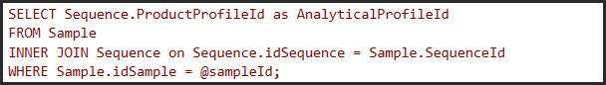
Join example
Version 3.2 introduced the $lookup operator
SQL query
MongoDB C# driver query
Notes:
Now that MongoDB supports join operations, we can store both relational and document data in the same database. This greatly expands the type of application that can be built on MongoDB and simplifies our deployment since we only have one database rather than two.

Slide 21
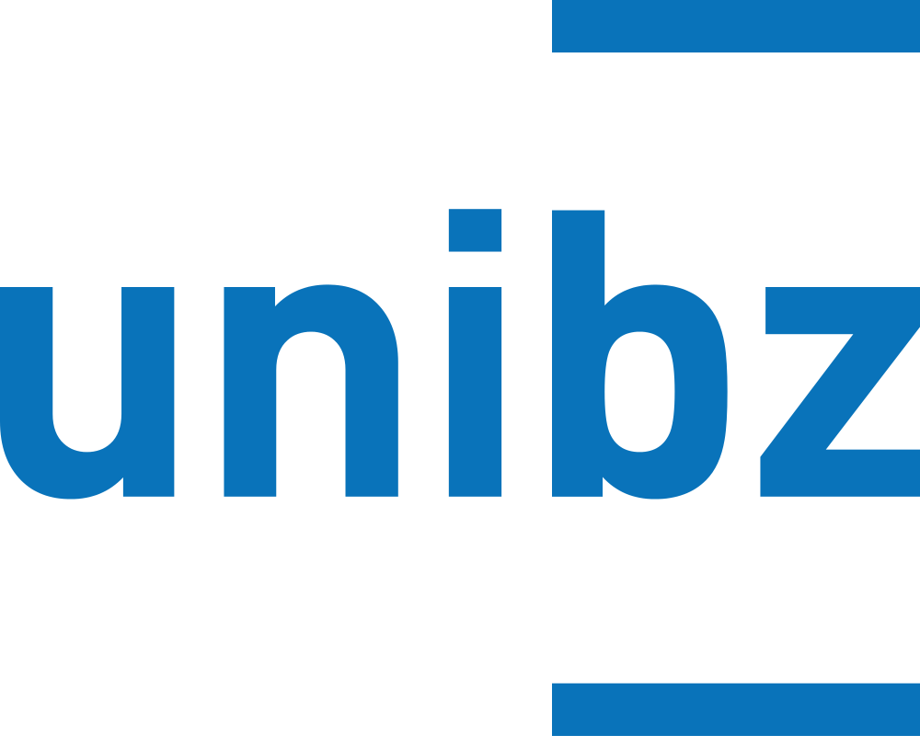
MongoDB has caught up to relational DBs
“”
Notably, we show that the MUPG (match, unwind, project, group) fragment is already at least as expressive as full relational algebra over (the relational view of) a single collection, and in particular able to express arbitrary joins.
– Bolzano University in Italy

Slide 22
The evolution of MongoDB
Document Validation
$lookup
Fast Failover
Simpler Scalability
Aggregation ++
Encryption At Rest
In-Memory Storage Engine
BI Connector
MongoDB Compass
APM Integration
Profiler Visualization
Auto Index Builds Backups to File System
Linearizable reads
Intra-cluster compression
Views
Log Redaction
Graph Processing
Decimal
Collations
Faceted Navigation
Spark Connector ++
Zones ++ Aggregation ++
Auto-balancing ++
ARM, Power, zSeries
BI Connector ++
Compass ++
Hardware Monitoring
Server Pool
LDAP Authorization
Encrypted Backups
Cloud Foundry Integration
Doc-Level Concurrency
Compression
Wired Tiger Storage
≤50 replicas
Auditing ++
Ops Manager
$out
Index Intersection
Text Search
Field-Level Redaction
LDAP & x509
Auditing
Hash-Based Sharding
Roles
Kerberos
On-Prem Monitoring
1.0
2009
2.4
GA 2013
2.6
GA 2014
3.0
GA 2015
3.2
GA 2015
Atlas
3.4
GA 2016
Headline Features by Release
Notes:
As you can see each release brings a new set of features. Here are a few of my favorite features.
[optional]
MongoDB has climbed to the number 4 slot on db-engines ranking of most popular databases. This is based on metrics including job postings, stack overflow questions and google searches. Mongo is only behind Oracle, MySql, and SqlServer. Oracle which was first released in 1979, Sql Server in 1989, MySql in 1999 and MongoDB in 2009.

Slide 23
MySQL vs. MongoDB
Notes:
Let me talk for a moment about some performance, scalability and cost comparisons that we did with MySql vs. MongoDB
We apply the same scientific rigor as our customers when making a decision on which database to use.

Slide 24
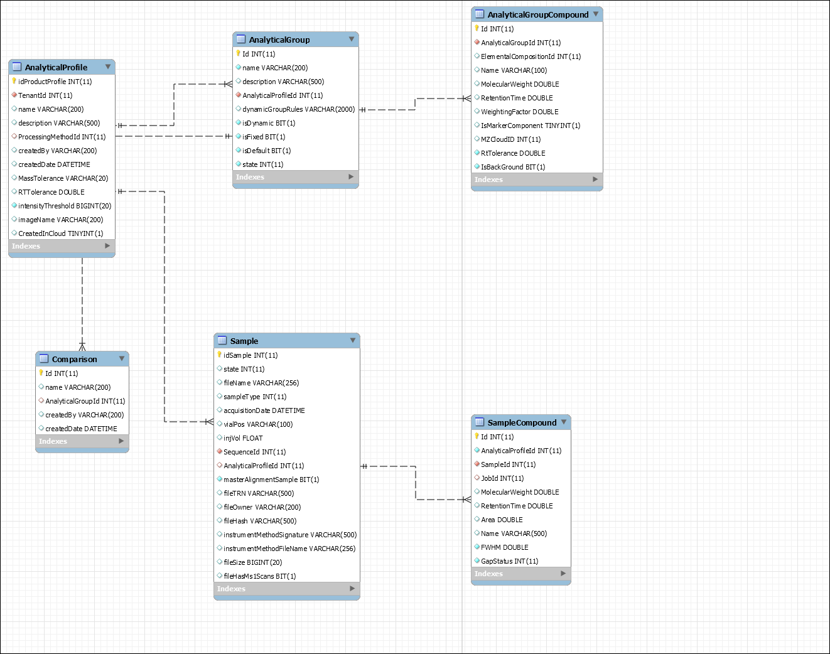
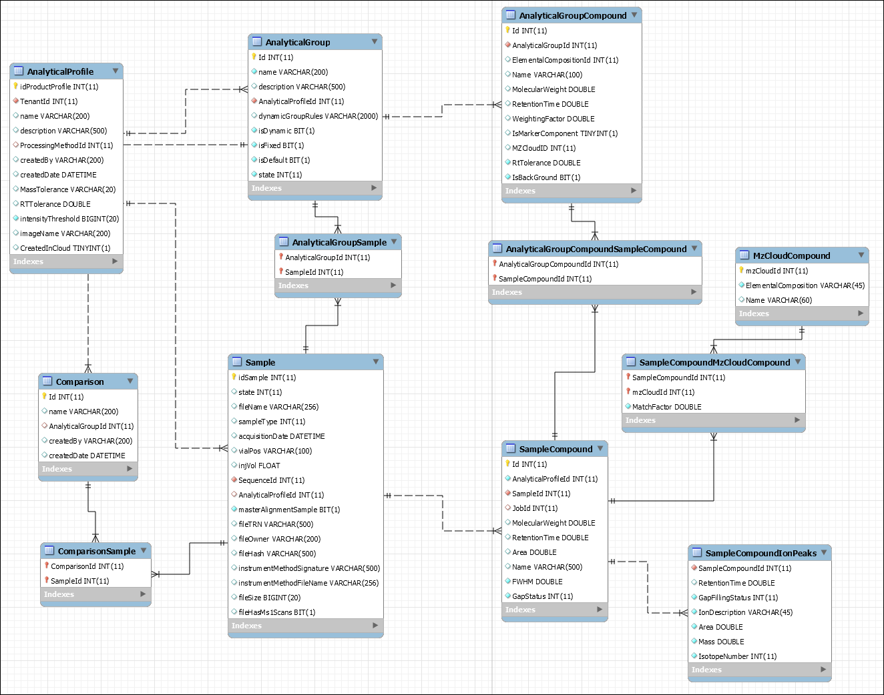
Database schema
MySQL
schema
MongoDB schema

Slide 25
Inserting data: MongoDB vs. MySQL
Inserting 1,615 chemical compound records into two parent-child tables.
To optimize the MySQL query, we turned off foreign keys during insert and used a string builder to create a bulk insert SQL statement. This improved insert performance by a factor of 360.
Compare to MongoDB.
Database | Milliseconds | Lines of code
MySQL not optimized | 147,600 (2.5 minutes) | 21
MySQL optimized | 410 | 40
MongoDB | 68 | 1
Notes:
To test if MongoDB could give us the performance we need we used the same scientific rigor that our customers use in their experiments. We ran a performance comparison between MongoDB and MySql Aurora for inserting data into the two databases.
If I were to reduce my presentation to one slide, this would be that slide. This is a staggeringly awesome improvement in developer productivity.
For this test, we inserted into two tables, a parent and child table containing the compound results. The un-optimized query inserted one row into the parent table retrieves the newly created primary key, sets that as the foreign key on the child object and inserts the child object and repeat thousands of times. This took 147,000 seconds. Next we optimized by performing a batch insert for all the parent records and then a batch insert of all the child records. This reduced the time by a factor of 350.
We ran the same insert with MongoDB with only one line of code, and it was still 6x faster.
TODO: run test with larger data set.

Slide 26
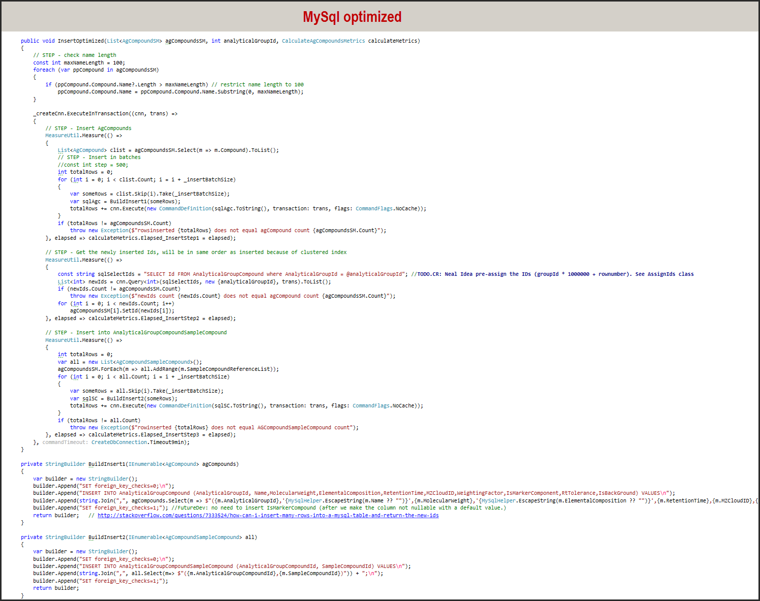
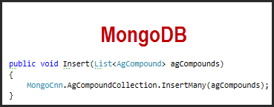
Inserting data: MongoDB vs. MySQL
Notes:
Here is a screenshot of the lines of code with MySql vs. MongoDB.
MySQL optimized: 40 lines
MongoDB: 1 line

Slide 27
Selecting data: MongoDB vs. MySQL
Query 600,000 rows of SampleCompound result data
To optimize the MySQL select query, we created a dictionary to lookup child records for each parent, this improved performance by a factor of 300, optimization effort: 2 engineers and 2 weeks.
Database | Seconds | Lines of code
MySQL not optimized | 2,400 (4.1 minutes) | 20
MySQL optimized | 8.2 | 29
MongoDB | 17.5 | 7

Slide 28
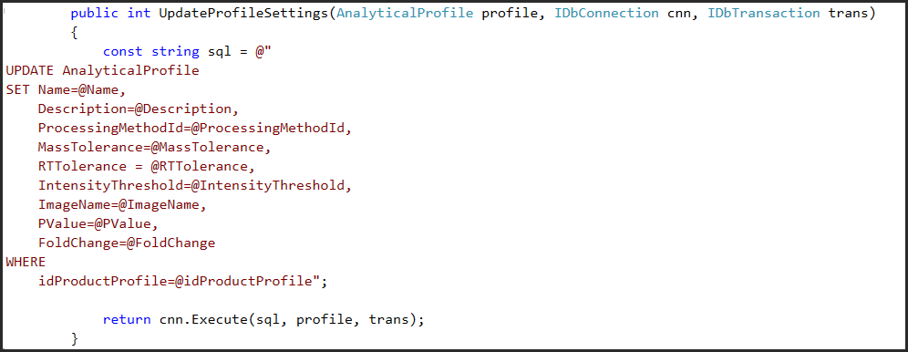
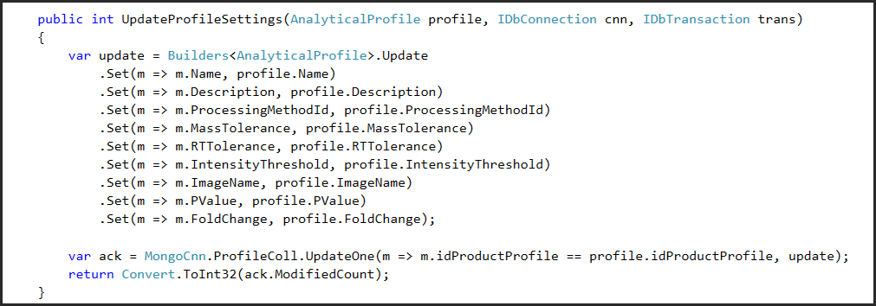
Update: MongoDB vs. MySQL
Notes:
Similar number of lines of code and performance.
SQL Injection: Nice advantage of MongoDB is that the queries are strongly typed and no chance of SQL injection. After all these years SQL injection is still the number one security threat.

Slide 29
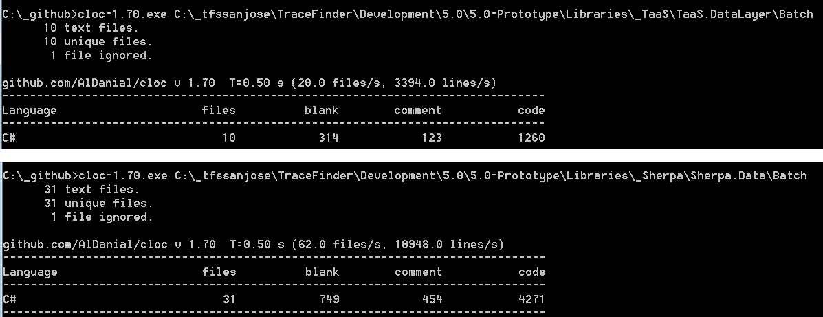
Migrating to MongoDB reduced code by 3.5x
 | SQLite | MongoDB
Data Layer Lines of Code | 4271 | 1260
Notes:
Here is another example of developer productivity gains by switching to MongoDB. The application used in some major sporting event in past summer - TraceFinder. The entire application is a million lines of code, for the data layer we reduced from 4k lines to 1k.

Slide 30
MongoDB compared to DynamoDB
MongoDB | DynamoDB
Anywhere | AWS
Rich Ad-hoc Query Language + IDE | No Ad-hoc query language
Many operators (Joins, Aggregation, etc.) | Fewer operators
Excellent Performance | Excellent Performance
Easy to deploy (with Atlas) | Easy to Deploy each table
Adding tables requires no configuration changes | Adding tables requires additional configuration and cost
Easy to use from AWS services but not natively integrated | Native integration with AWS Services: IAM, VPC, Lambda, Kinesis
Released in 2009 | Released in 2012
Notes:
Here I am contrasting DynamoDB and MongoDB, I think that as usual the answer to which database is best for your application is “It depends”, my product owner always says, I don’t need better decisions, I need better choices and both of these databases are used heavily by ThermoFisher cloud successfully.
Features..
I expect both of these databases will continue to grow in popularity at a much faster rate than relational databases.
The most obvious difference is that Dynamo is an AWS-only service and Mongo runs anywhere.
Rich query language:
With MongoDB, I can answer questions like which instruments had the highest utilization last month or what is the pump pressure were I see my pumps begin to fail. And I can find this out without writing any code using ad-hoc queries.
With MongoDB, I can take advantage of rich features like joins, document validation, strongly typed queries, decimal data type, views, graph queries, and grouping, the aggregation pipeline, map-reduce, native spark connector, etc.
According to db-engines, MongoDB and DynamoDB are the two top rated database in the category of Document DBs. MongoDB has a score of 325 and DyamoDB a score of 29.
Native Integration with AWS: For example, if you want to take advantage of the native triggers available to execute a Lambda statement

Slide 31
MongoDB vs. S3 performance
Download 220 KB object from MongoDB was 7x faster cold, and 3x faster when warm
 | MongoDB | Amazon S3
Retrieve document first time | 68 ms | 468 ms
Retrieve document second time | 13 ms | 38 ms
Notes:
Please don’t interpret this slide as you should always use MongoDB over S3. That would not be wise. S3 would far out perform MongoDB in other scenarios. In this particular case, MongoDB is a much better choice.
This measurement was taken by running C# code from EC2 instance in AWS US-East region.
The title of this slide might strike you as odd, comparing S3 with MongoDB.
S3 is an powerful AWS service which can be used to store multi gigabyte files and tiny JSON objects. It is a key-value store but by carefully selecting keys you can use S3 like a simple database with tables and rows a set of S3 objects with the same key prefix can function like a database table, the advantage is that you have a very inexpensive, serverless, highly available database. But as your application gets more complex you miss out on the rich query capabilities of a full relational or document database.
For our Real-time chromatogram we realized a couple orders of magnitude in savings in network and CPU consumption on our application servers by not having to download the entire S3 object and filter it down, we were able to do this instead on the database.
[Reference]
Performance measurement code: "C:\_git\CloudAgent\srcapi\Ironclad.Bootstrap\Repo\RealtimeChroDalBootstrap.cs"
[Note]
Serialzed JSON to S3 using Newtonsoft to S3 which is 20% larger objects compared with Mongo Bson. (storage on disk is even more of a contrast)

Slide 32
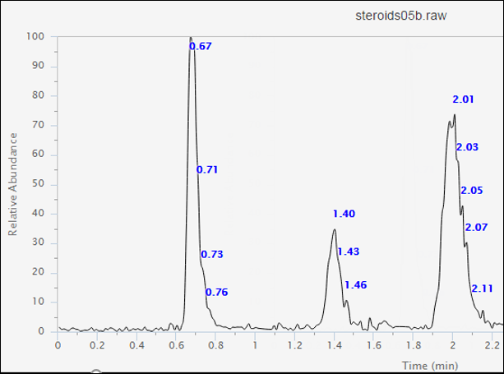
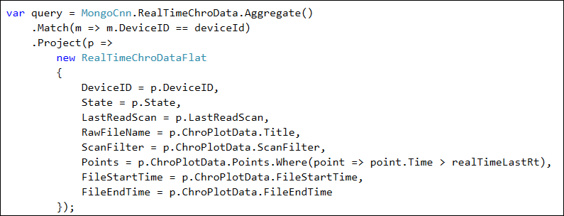
MongoDB vs. S3 performance
MongoDB 11x faster than S3 in the use case of partial document loading
 | MongoDB | S3
Data size | 400 Bytes | 2.1 MB
Performance | 19 ms | 214 ms
Notes:
For our Real-time chromatogram we realized a couple orders of magnitude in savings in network and CPU consumption on our application servers by not having to download the entire S3 object and filter it down, we were able to do this instead on the database.
[Reference]
Performance measurement code: "C:\_git\CloudAgent\srcapi\Ironclad.Bootstrap\Repo\RealtimeChroDalBootstrap.cs"
[Note]
Serialzed JSON to S3 using Newtonsoft to S3 which is 20% larger objects compared with Mongo Bson. (storage on disk is even more of a contrast)

Slide 33
Reducing processing from days to minutes

Slide 34
Frameworks used to parallelize algorithms
AWS Lambda
Docker and Amazon ECS
Spark and Elastic Map Reduce
Notes:
With all the time we are saving writing and optimizing data layer code, we are able to invest in improving our algorithms, improving the user experience, and improving the processing infrastructure.

Slide 35
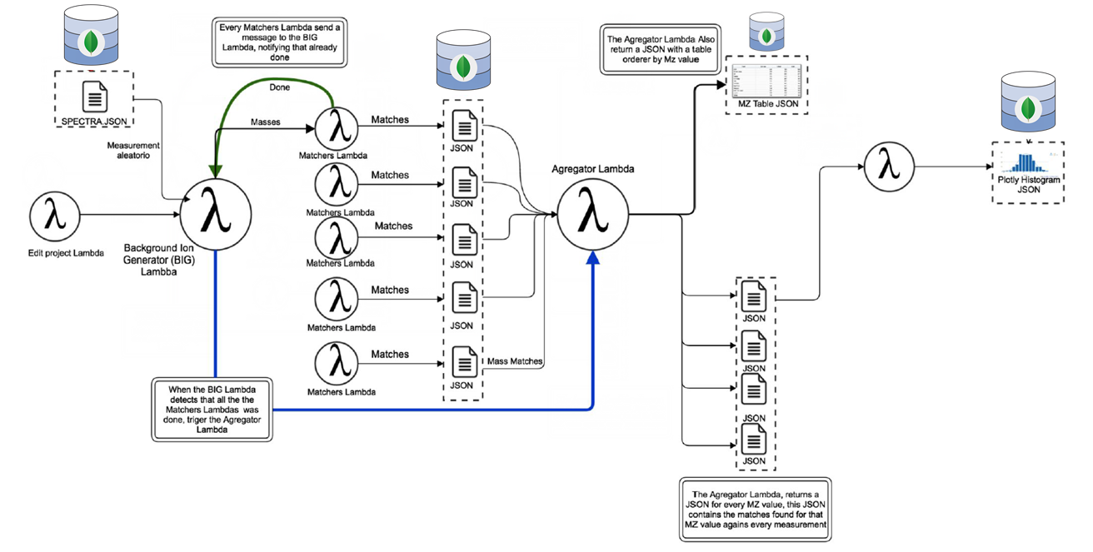
Parallel data processing

Slide 36
Why Atlas?
Easy
Performant
Seamless Migration
Robust
No downtime, even when scaling up
Notes:
In summary, we use MongoDB Atlas because it is Easy, Performant, easy to migrate to, robust, and no downtime, even when scaling up. But perhaps the best way to express the value of Atlas is with a story. Before I worked for ThermoFisher Scientific I was a Microsoft consultant and companies would hire me to upgrade their Sql Servers over the weekend. This was a stressful weekend with a lot of risk and at the end it really didn’t feel like we had accomplished anything of value to the customer. With MongoDB Atlas I don’t have to install OS Service packs or perform database upgrades. I can spend my time worrying about what is import to my customers.

Slide 37
Building MongoDB Atlas on Amazon Web Services

Slide 38

Operations burden
PATCHES
UPGRADES
SECURITY
BACKUPS
RECOVERY
99.999% UPTIME
UPSCALE
DOWNSCALE
PERFORMANCE
UAT
STAGING
MONITORING
ALERTS
PROVISION
CONFIGURE
INSTALL

Slide 39
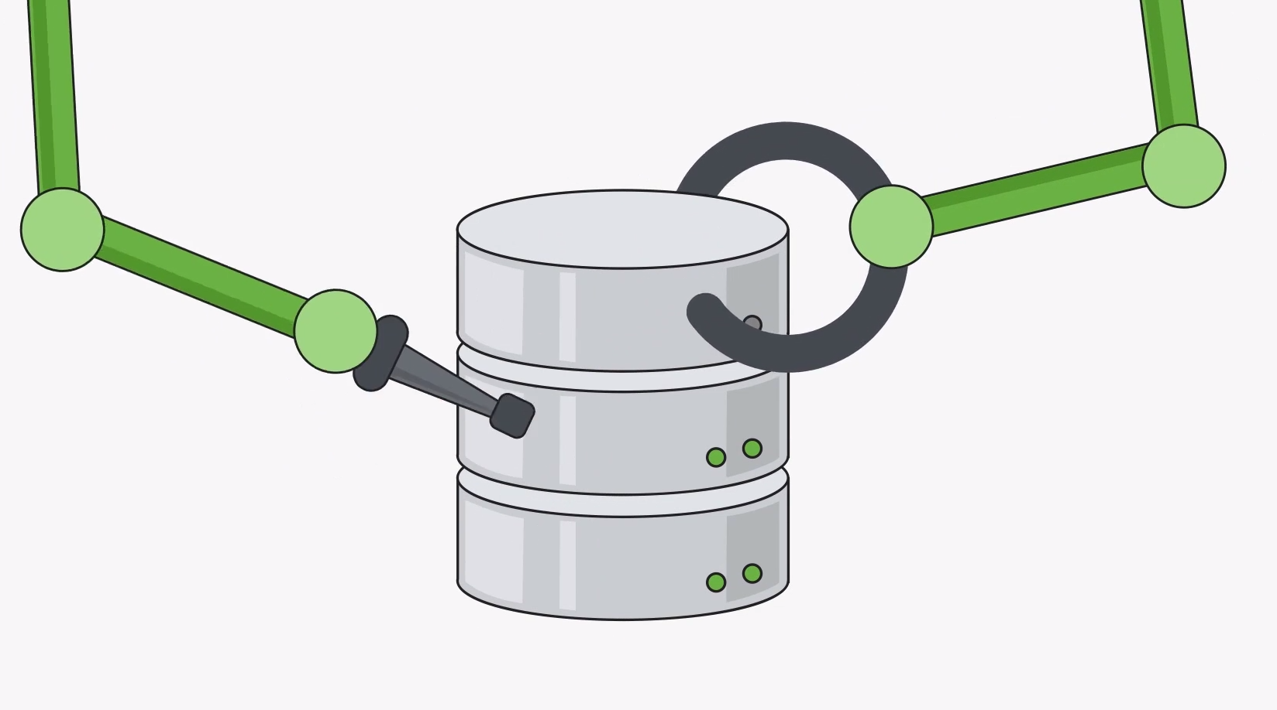
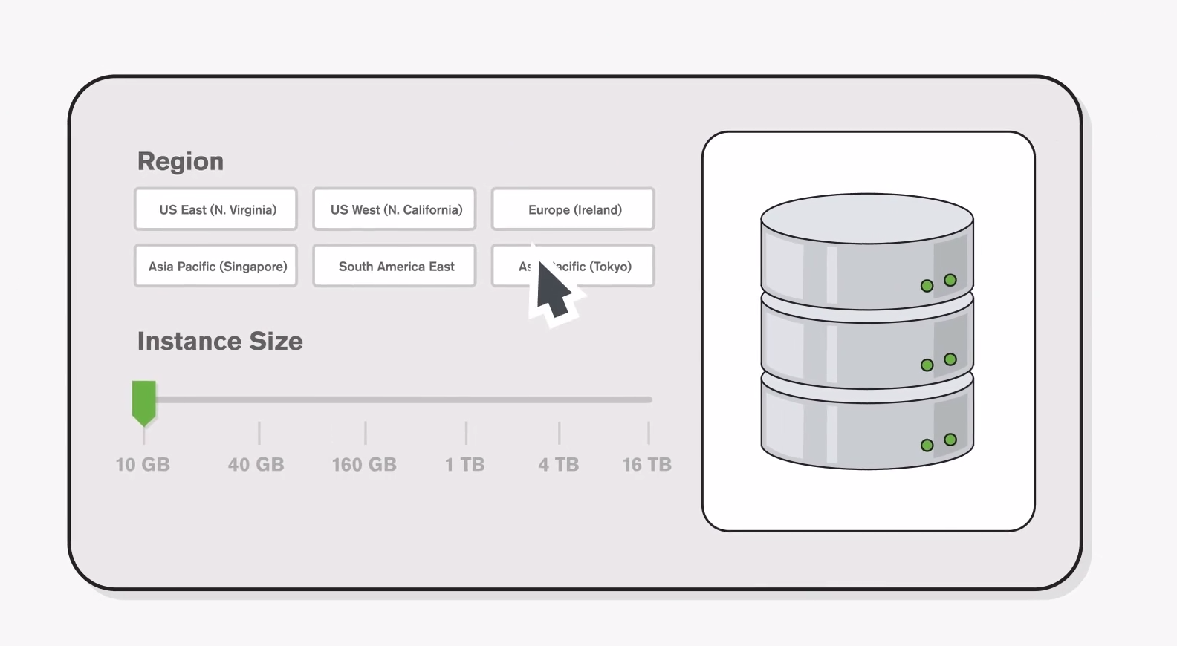
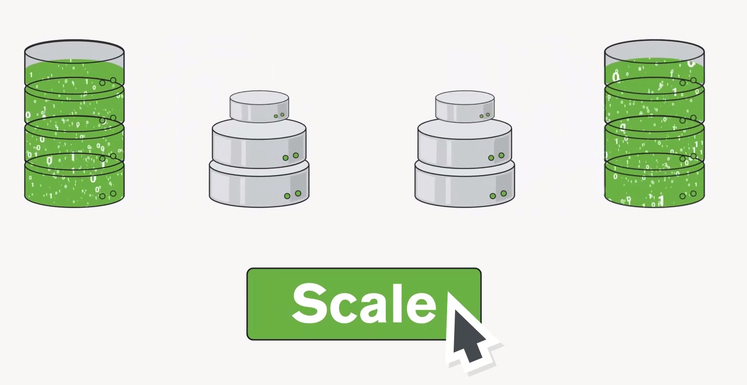
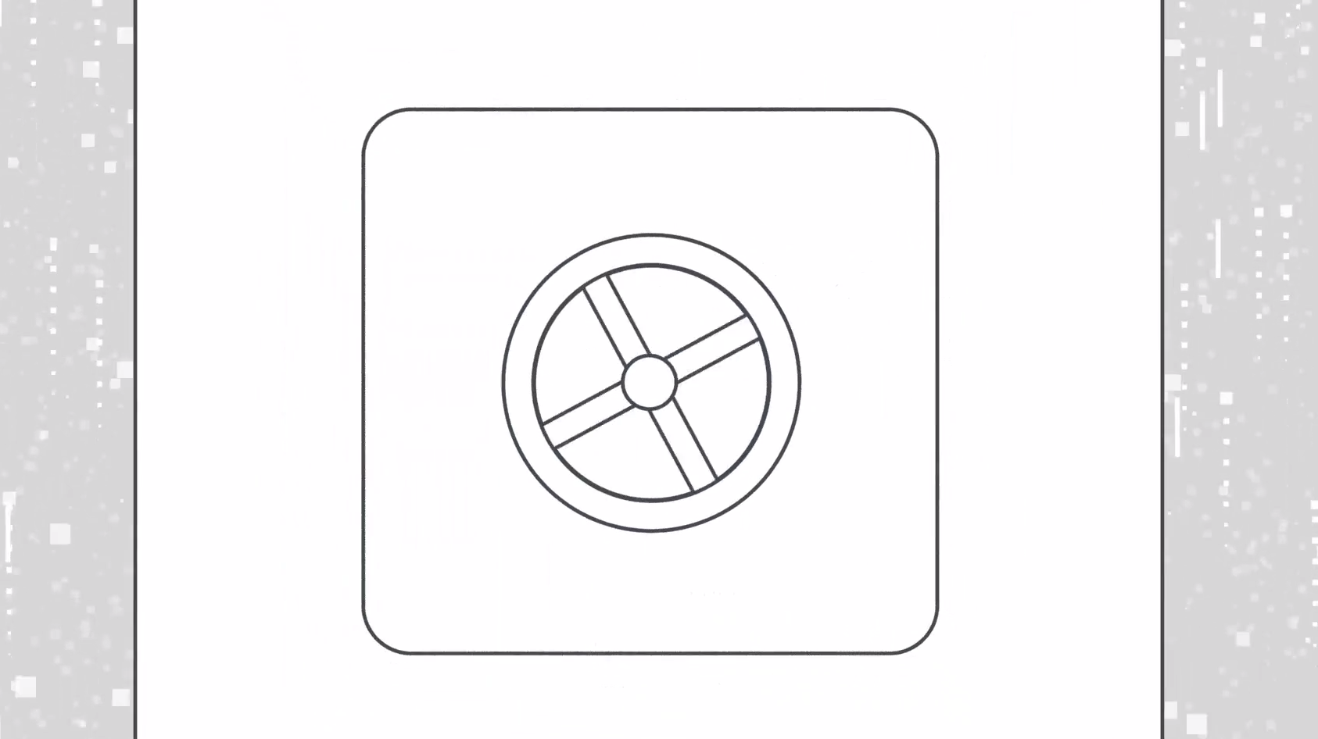
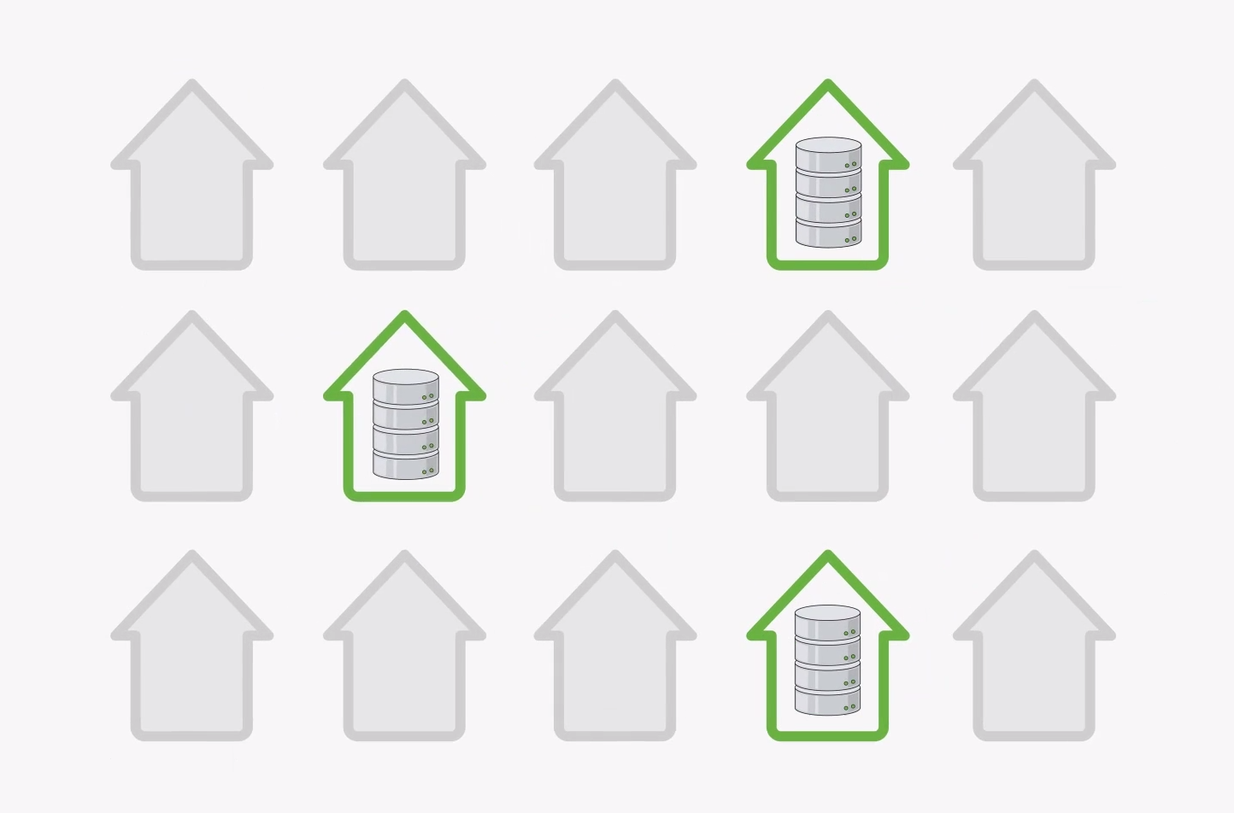
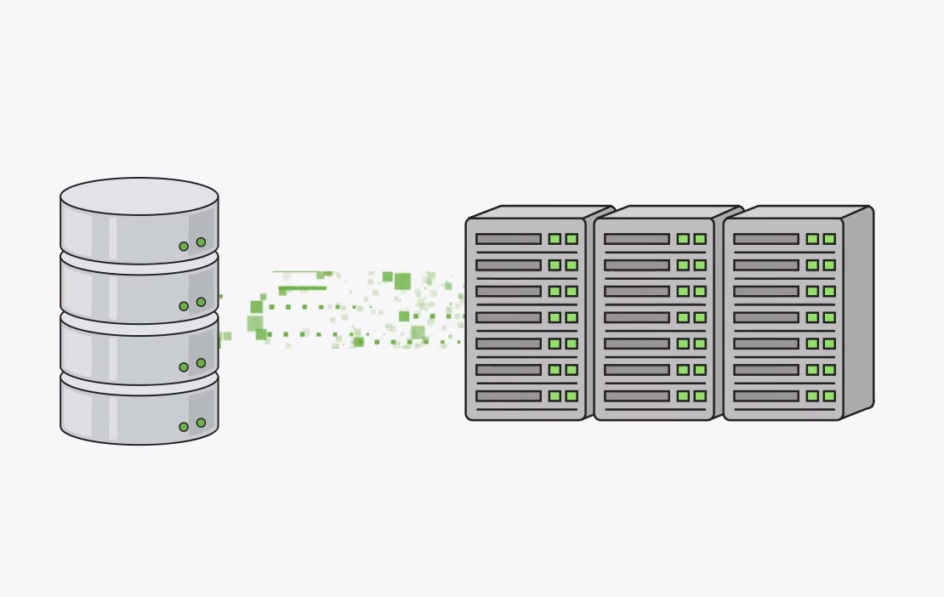
Database as a service for MongoDB
Automated
Available On-Demand
Elastically Scalable
Secure
Highly Available
Automated Backups

Slide 40
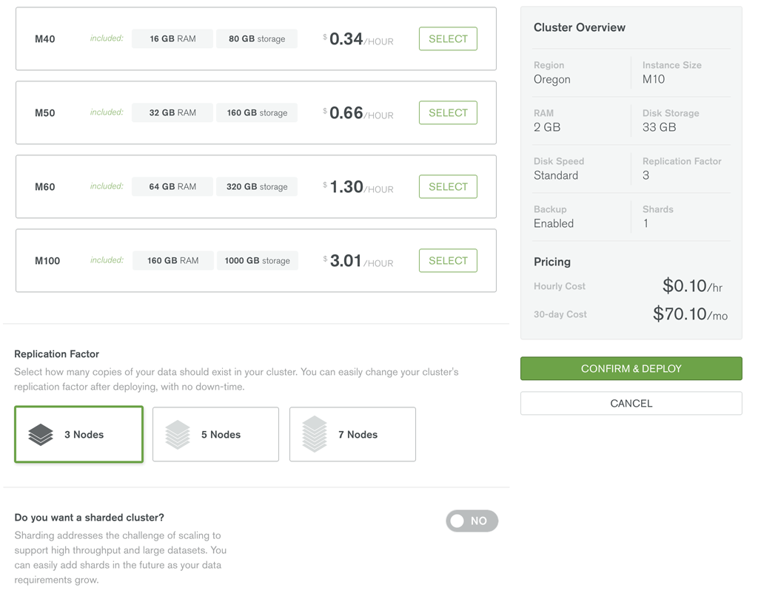
Cluster features
Fully managed MongoDB clusters
Customer only needs to choose the shape and size of the cluster
Instance size (CPU and RAM)
Replication factor
Number of shards
Disk space
Disk speed
Screenshot of create dialog

Slide 41
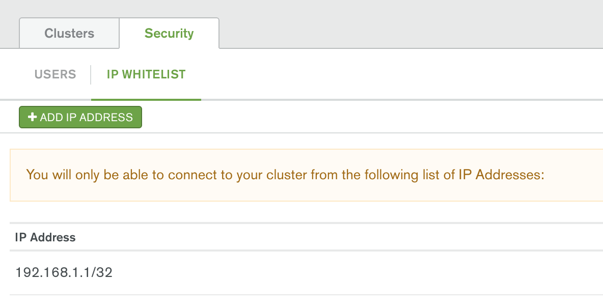
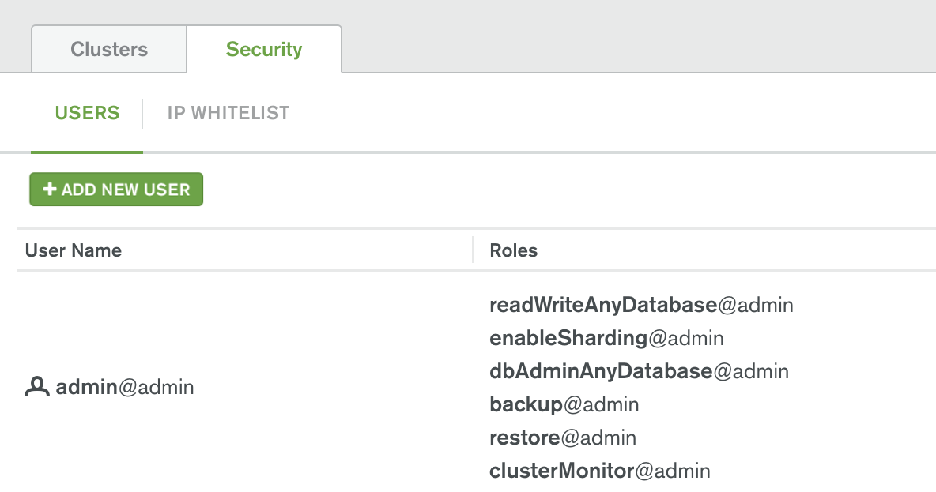
Security features
VPC peering
IP address whitelist
SCRAM-SHA-1 authentication
readWriteAnyDatabase
enableSharding
clusterMonitor
SSL
Using well-known CA
Trust system CAs by default

Slide 42


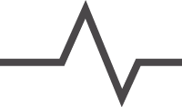
Key components
Monitoring
Backup
Automation

Slide 43
Customer container with replica set
Availability Zone A
Availability Zone B
Availability Zone C
AWS Account X—Region Y
VPC (Customer N)
Subnet A
Subnet B
Subnet C
mongod—27017
mongod—27017
mongod—27017

Slide 44
Customer container with sharded cluster
Availability Zone A
Availability Zone B
Availability Zone C
AWS Account X—Region Y
VPC (Customer N)
Subnet A
Subnet B
Subnet C
S
S
S
S
S
S
shard0
shard1
shard0
shard1
shard0
shard1
shard2
config
shard2
config
shard2
config

Slide 45
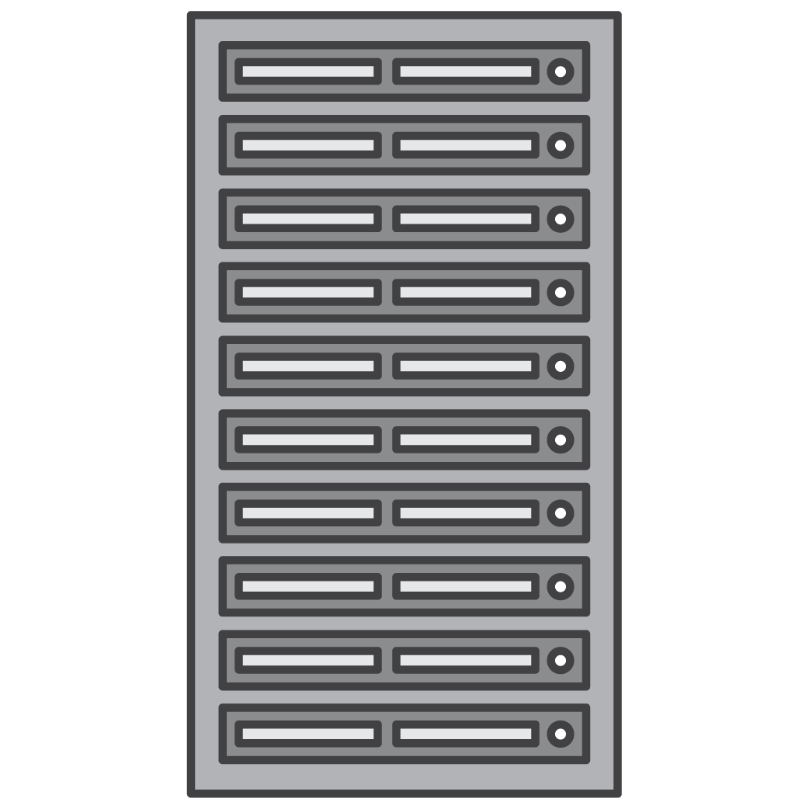

IP firewall using security groups
App Server
Jump Box
One security group per VPC applied to all Amazon EC2 instances
Three classes of security rules:
MongoDB traffic between cluster members
MongoDB traffic between application and clusters
SSH traffic between production support jump box and EC2 instance
mongod—27017
mongod—27017
mongod—27017

Slide 46
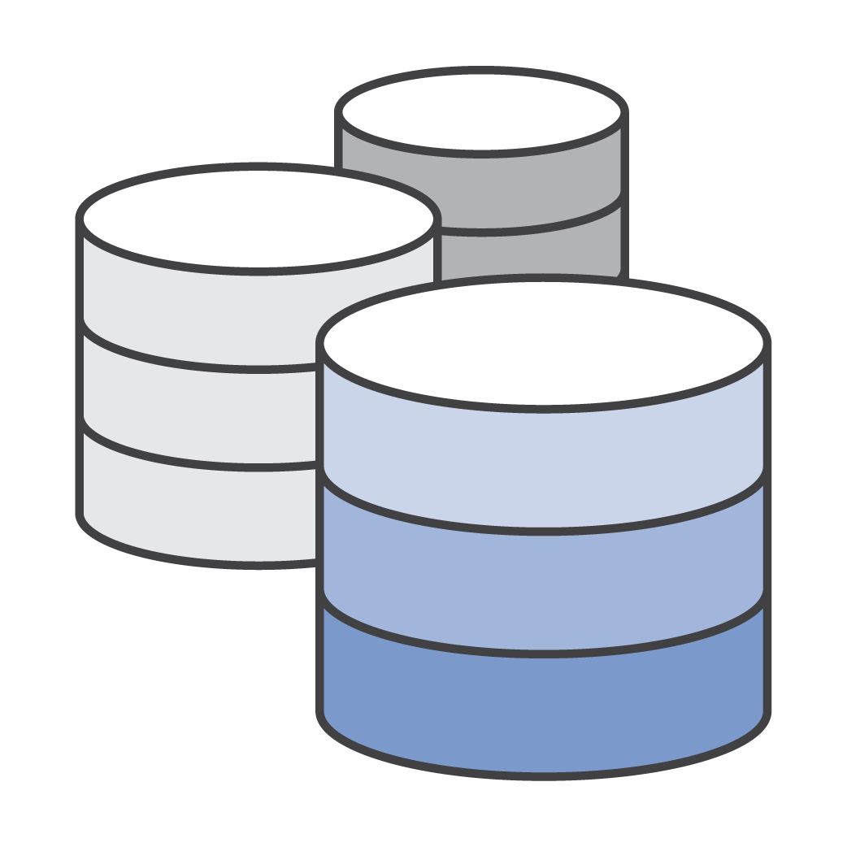
VPC peering
Your VPC
Atlas VPC
Elastic LB
AZ 1
AZ 2
AZ 3
CIDR Block: 10.0.0.0/16
CIDR Block: 172.31.248.0/21
10.0.0.0/16
173.31.248.0/21

Slide 48

“”
We want prime to be such a good value, you’d be irresponsible not to be a member.
—Jeff Bezos

Slide 49
Migrate to MongoDB Atlas today!
Use promo code
getAtlas
*$100 Value

Slide 51
Questions?

